Slide 1

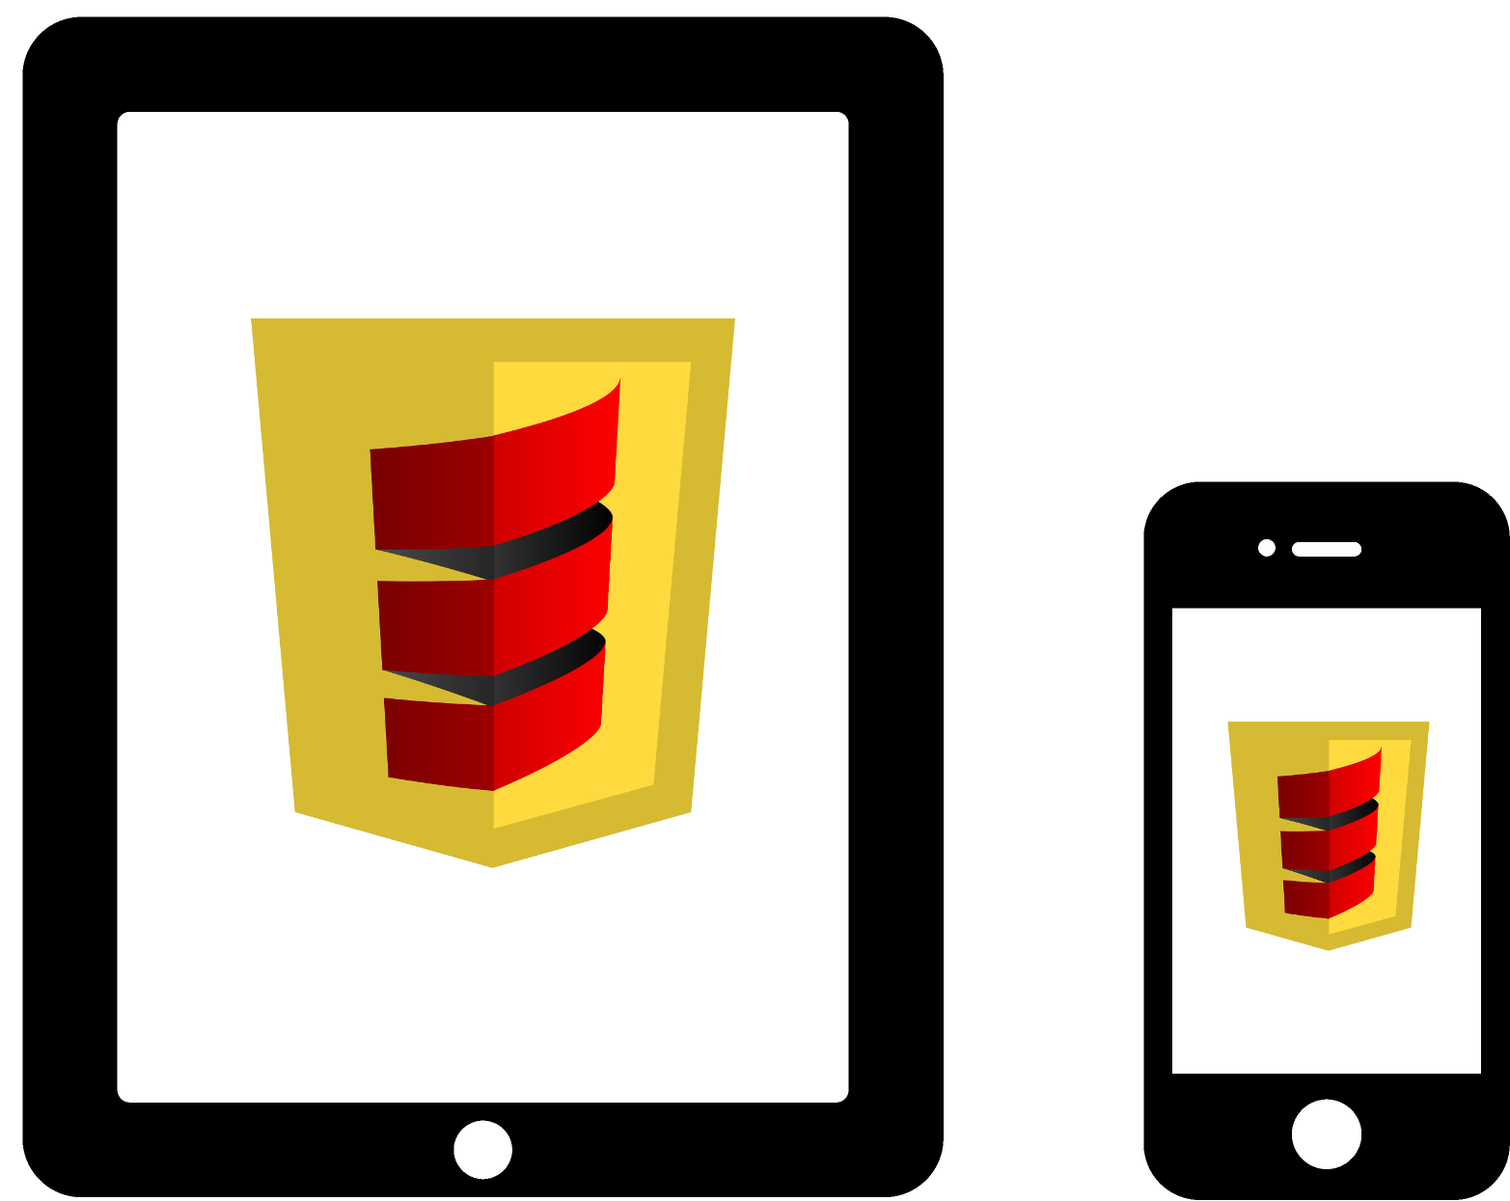
From Swing to Mobile

Slide 2








Technologies

Slide 3
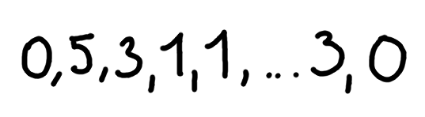

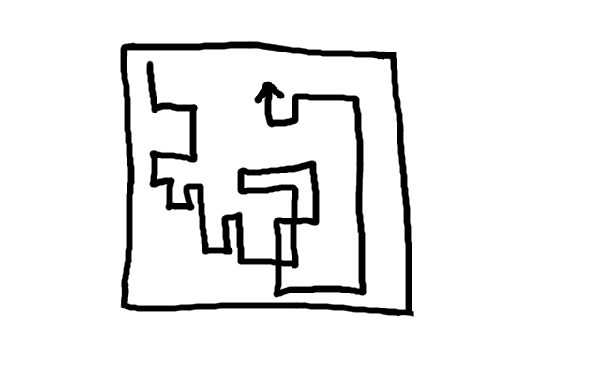
Program Components
Evaluator
Video Creator
GUI

Slide 4
Modularisation
swing
scala-js
component implementations
component interfaces
core

Slide 5
GUI Logic (in core module)
case class GuiController(
canvas: DoctusCanvas, selectBox: DoctusSelect[Video],
startButton: DoctusButton, scheduler: DoctusScheduler,
framesPerSecond: Int, stageParams: StageParams, allVideos: List[Video]) {
// Global state
var index = 0
var stagesOpt: Option[List[NumberedStage]] = None
// Fill the select box
allVideos.zipWithIndex.foreach {
case (video, index) => selectBox.addItem(index, video)
}
// Register callback for start button
startButton.onClick { () =>
val video = selectBox.selectedItem
index = 0
stagesOpt = Some(VideoCreator.create(List(video), framesPerSecond))
}
// Start scheduler
scheduler.start(() => canvas.repaint, (1000.0 / framesPerSecond).toInt)
// Register callback for repaint
canvas.onRepaint { (cg: DoctusGraphics) =>
{
val da: DrawArea = DrawArea(Pos(0, 0), Rec(canvas.width, canvas.height))
stagesOpt match {
case Some(stages) => {
stages(index).stage.paint(cg, da, stageParams)
if (index >= stages.size - 1) stagesOpt = None
}
case None => { Intro.stage(index).paint(cg, da, stageParams) }
}
index += 1
}
}
}
Only interfaces

Slide 6
Swing Implementation
object VideoSwingMain extends App {
val canvas = new DoctusPanel()
val comboBox = new ComboBox(List.empty[Video])
val startButton = new Button("Start")
val mf = new MainFrame() {
// Define the layout of the components
contents = new BorderPanel() {
val compPanel = new FlowPanel(comboBox, startButton)
add(compPanel, BorderPanel.Position.North)
add(canvas, BorderPanel.Position.Center)
}
title = "Akka Workshop Reloaded"
iconImage = new ImageIcon(getClass.getClassLoader().getResource("icon.png")).getImage
size = new Dimension(800, 600)
}
val framesPerSecond = 20
val params = StageParams(10, ImageProvider_V01, 0.8, 0.05)
val videos = AkkaWorkshopResultsVideos.all
GuiController(
SwingCanvas(canvas),
SwingSelect[Video](comboBox),
SwingButton(startButton),
SwingScheduler(canvas),
framesPerSecond,
params,
videos)
mf.visible = true;
}
Wrapper are here created

Slide 7
Scala-JS Implementation 1/2
<!DOCTYPE html>
<html>
<head>
<title>canrob</title>
<meta http-equiv="Content-Type" content="text/html; charset=UTF-8" />
<script type="text/javascript" src="js/jquery-1.10.2.min.js"></script>
<script type="text/javascript" src="js/jquery.mobile-1.4.1.js"></script>
<link rel="stylesheet" type="text/css" href="js/jquery.mobile-1.4.1.css">
</head>
<body>
<div id="centerDiv" style="padding: 3px; max-width: 900px; margin-left: auto; margin-right: auto;">
<h1 style="background-image: url('src/main/resources/background.png'); ">
Top 100 Results of the Scala Akka Workshop Reloaded
</h1>
<p>
<select id="selectBox"></select>
<button id="startButton">Start</button>
</p>
<canvas id="canvas" style="padding: 3px; width: 99%; max-width: 900px;">Canvas tag not supported</canvas>
<p style="padding-bottom: 30px">For details about the workshop
<a href="http://www.meetup.com/scala-vienna/events/162110952/">see...</a>
</p>
</div>
<script type="text/javascript" src="target/scala-2.10/canrob-scalajs-extdeps.js"></script>
<script type="text/javascript" src="target/scala-2.10/canrob-scalajs-intdeps.js"></script>
<script type="text/javascript" src="target/scala-2.10/canrob-scalajs.js"></script>
<!--
<script type="text/javascript" src="js/canrob-scalajs-opt.js"></script>
-->
</body>
</html>
Components are all created here

Slide 8
Scala-JS Implementation 2/2
object VideoScalajsMain {
// Comes here on every refresh (update)
def main(): Unit = {
// GUI Components form the HTML-Page
val center: HTMLDivElement = dom.document.getElementById("centerDiv").asInstanceOf[HTMLDivElement]
val canvas: HTMLCanvasElement = dom.document.getElementById("canvas").asInstanceOf[HTMLCanvasElement]
val selectBoxElem = dom.document.getElementById("selectBox")
val selectBox: JQuery = jQuery(selectBoxElem.asInstanceOf[HTMLSelectElement])
val startButtonElem = dom.document.getElementById("startButton")
val startButton: JQuery = jQuery(startButtonElem.asInstanceOf[HTMLButtonElement])
canvas.width = center.clientWidth
canvas.height = canvas.width * 0.7
// Some configuration
val framesPerSecond = 15
val params = StageParams(10, ImageProvider_V01, 0.7, 0.07)
val allVideos = AkkaWorkshopResultsVideos.all
// Wrap the javascript components
val dcanvas: DoctusCanvas = ScalajsCanvas(canvas)
val dselectBox: DoctusSelect[Video] = ScalajsSelect[Video](selectBox, (v: Video) => v.text)
val dstartButton: DoctusButton = ScalajsButton(startButton)
val dscheduler: DoctusScheduler = ScalajsScheduler(canvas)
// Start the platform independent controller
GuiController(dcanvas, dselectBox, dstartButton, dscheduler, framesPerSecond, params, allVideos)
}
}
Components are all created here

Slide 9
Going Mobile

Slide 10
Plus/Minus/Unknown
Almost only Scala to write
No Java libraries can be used
Easy testable
Easy debuggable
Access to mobile-APIs
Remote access (Akka remote)

